Slide 1


Future Farm Landscapes - a new approach for engaging farmers in planning for climate change
Presented by: Mary Crawford,
Sustainable Farming
Natural Resources Eyre Peninsula

Slide 2
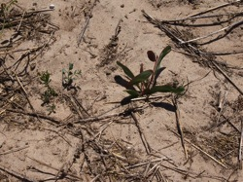
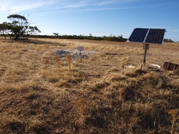
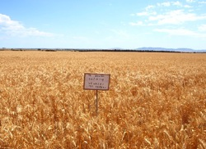
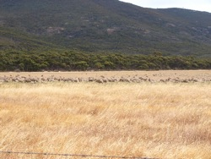
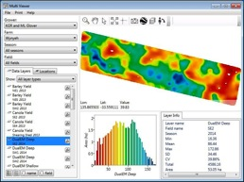
Participants vision
“A productive, profitable and sustainable farm business that considers the whole of landscape in a changing climate.”

Slide 3
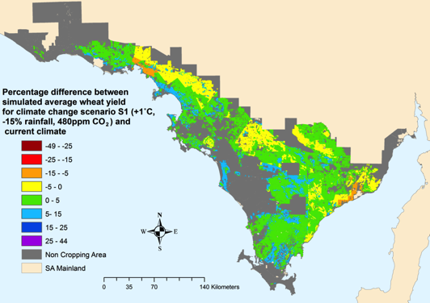
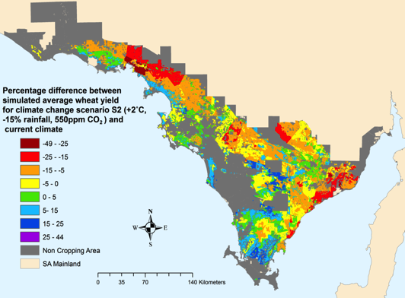
Production impacts of climate change
2025
2050

Slide 4
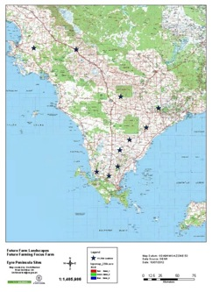
    Focus group
    10 farm businesses
    Encouraged all members of the farm business to be involved
    Experts used - that could provide practical applications to the information
    Sustainable production of grain and livestock using
    risk analysis
    Key Outputs
    Next Generation Property Plan
    Farm Carbon Story
    Action Plan
Remnant Vegetation Plans
Trials and demonstrations to fill knowledge gap
Notes:
Whole of property landscape planning:
Sustainable production of grain and livestock using risk analysis
Assessment of biodiversity values on the property and how these can be measured
Assessment of the farm carbon story

Slide 5
Production Risk Assessment
1 Retain for grain and livestock production
2 Requires management changes or land use change to remain viable
3 Requires substantial change in lands use to remain viable

Slide 6
Native Vegetation Value and Condition
1 High biodiversity value
2 Moderate biodiversity value, options to improve manage
3 Low biodiversity value, require substantial management to improve

Slide 7
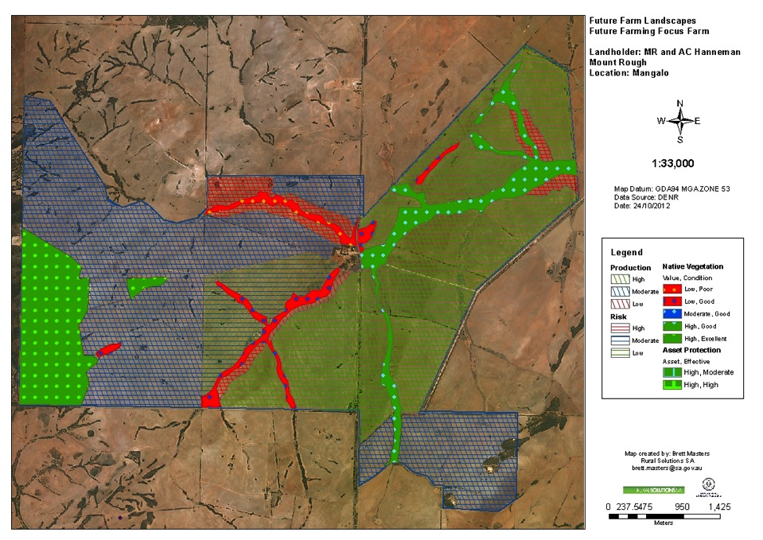
Next Generation Property Plan

Slide 8
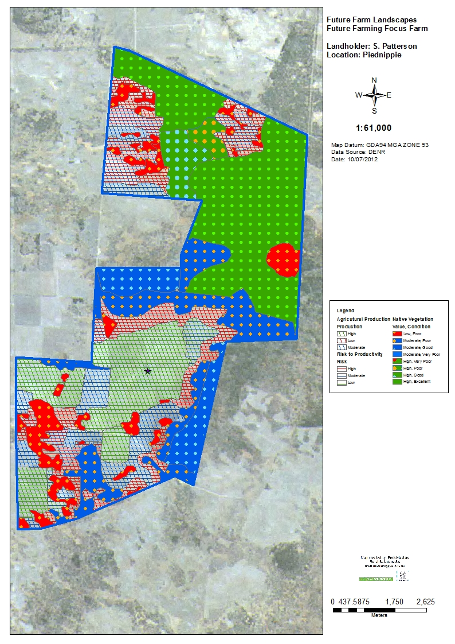

Slide 9
Notes:
Fencing and grazing Management
Area 1 yellow understory of native grasses – manage through appropriate grazing management – avoid grazing during flowering and seed set
Graze 1 – 3 times per year for 1 – 4 days with between 25 – 100 DSE/ha
Monitor impact of grazing from Kangaroos and control where necessary
Area 2 Red Expanding salt - spread of salt in into adjoining cropping land – fence areas to control grazing
increase soil cover
revegetate with salt tolerant grasses and shrubs

Slide 10
Action Plan
Patch no | Production | Risk | Priority | Production /Risk Assessment, knowledge gaps | Options to address risk | Time lines Immediate 0- 2 yrs Short term 2- 5 yrs Medium 5-10 yrs Long term 10 - 20 yrs
6 | Med | Med | 1 | Soil acidity reduces crop yield. Applied lime 5 years ago. pH 5.0 in CaCl₂ | Apply lime in 2015 @ 1 tonne/ha | 2015
7 | Low | High | 2 | Non wetting sand dune subject to blowouts, sheep camps. Suitability of clay and t/ha rates? | Plant to cereal rye and use temp electric fences when grazing paddock Clay spread the site. Clay may not be suitable. Fence off the site and sow veldt grass | 2013 2014 2016
3a 3b 3c | Low | Med |  | Wet and mushy | Delve and spade Incorporate organic matter | 2015

Slide 11
Farmer feedback
Helped gel the family in their thinking and direction
Valuable exercise for the next generation
Planning has allowed actions to be formalised
The FCS tool is an extremely worthwhile benchmarking tool
With the knowledge gained through the workshops we have added more detail to our Action Plan
Developed the action plan and identified the gaps – now need trials and demonstrations to evaluate some of the options
Trials and demonstrations need to be tied to the next generation as a way to expand the take up of the plans

Slide 12
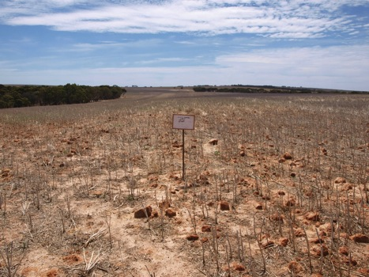
Where to from here?
Group continue to meet six monthly
Want trials and demonstrations
Economic evaluation of options
They will promote project outcomes to others
Trials/demos Established
Managing sodicity at depth
Incorporation of OM
Clay spreading & spading
Small grants program
Fencing and vegetation
Pasture establishment
Improving water supply

Slide 13
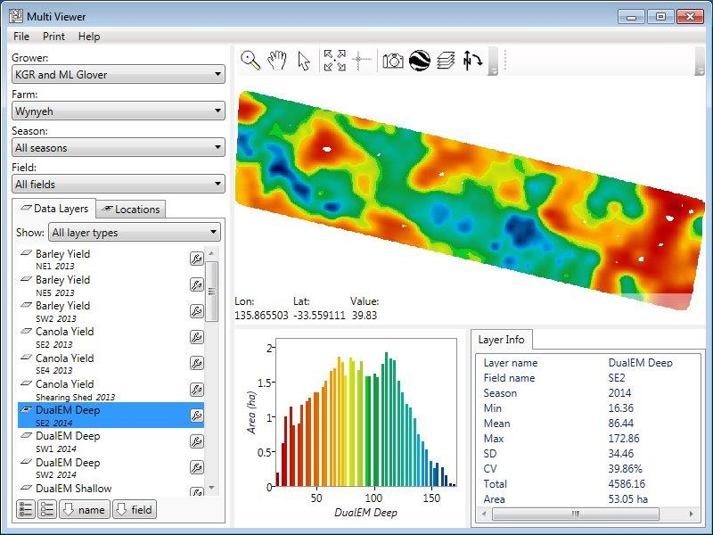
Notes:
Undertaking EM 38 mapping was the first step in kick starting the action plan by getting a better understanding of the production capabilities of individual paddocks. Each paddock was ground truthed to understand the limitations identified in each paddock and if what actions can be implemented to reduce the risk.
This had resulted in fine tuning production and risk zones down to paddock level.
The plan is to map the rest of the properties over the next 3 years.
EM 38 mapping was used in combination with the wheat yields to set up ‘P’ replacement zones and seeding rate zones. These maps will also be used to establish variable rate applications for crop nitrogen.
Gus was surprised at some of the results from the mapping and ground truthing of the paddocks. He found that there were more high risk areas than expected. The variability included depth of clay and depth of limestone. He felt that doing the ground work now will set him up for the future manage of his property.

Slide 14
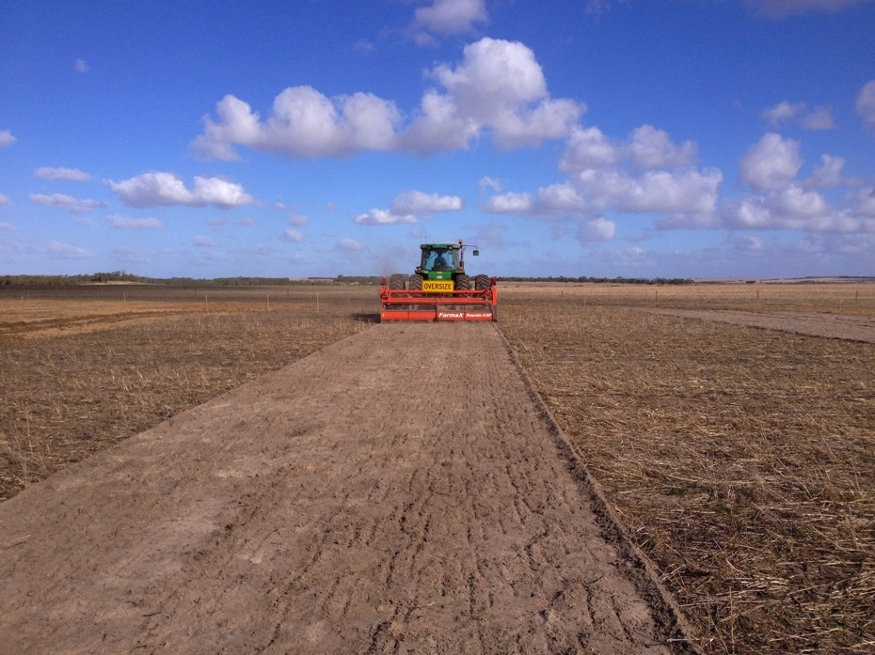
Managing Soil Acidity – various liming rates and deep incorporation

Slide 15
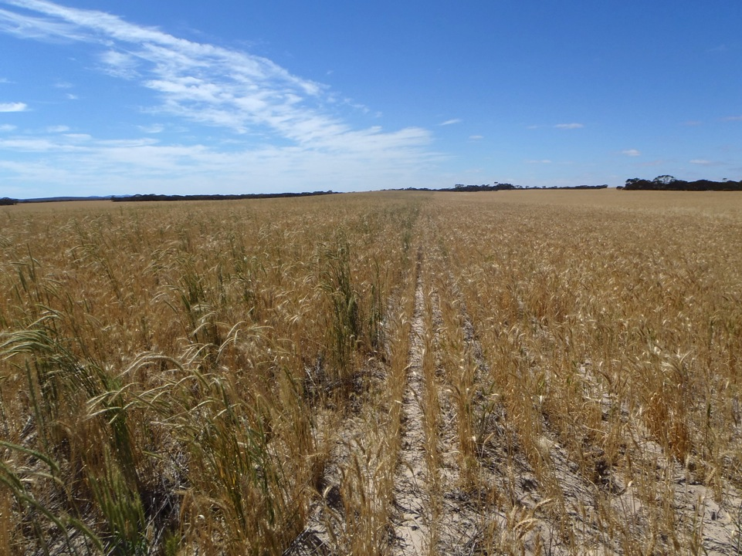
Increasing productivity potential - Reducing the risk Clay Spreading and delving on left on non wetting sands

Slide 16
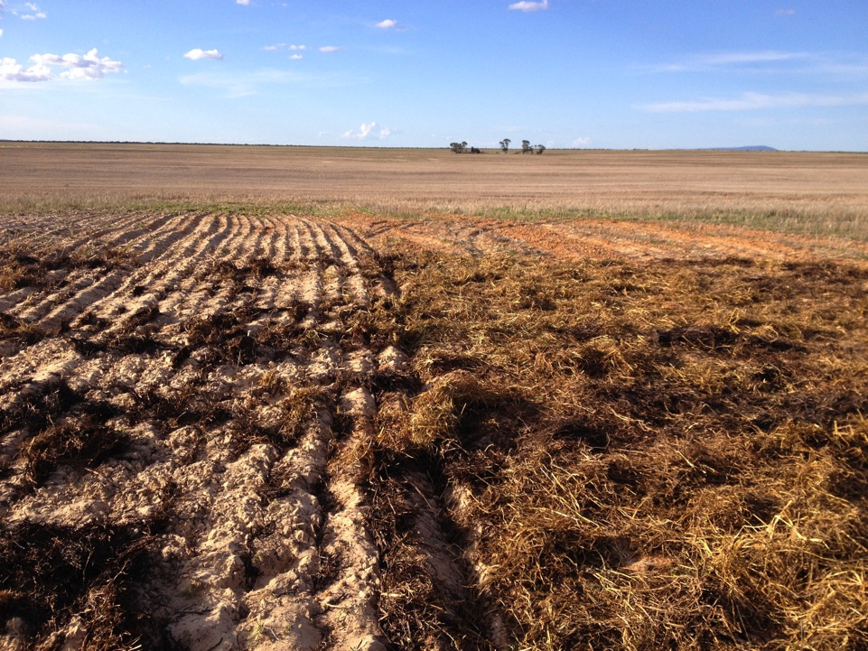
Clay Spreading and spading
Clay at 250ton/ha and 10 ton organic matter to 30 cms

Slide 17
Acknowledgements
Original Project was funded and supported by
Funders
Australian Wool Innovation Ltd., Eyre Peninsula NRM Board,
Caring For Our Country, Adelaide & Mount Lofty Ranges NRM Board
Co-deliverers
Mark Stanley, Regional Connections
Mary Crawford, Rural Solutions SA
Ian McFarland Rural Solutions SA
Dr Peter Hayman, SARDI; Dr Bill Cotching, University of Tasmania;
Prof. Wayne Meyer & Greg Lyall, University of Adelaide; Dr David Summers, CSIRO; Darren Ray, BoM; Ann Brown, Greening Australia; David Davenport, Rural Solutions SA; Leanne Sherriff, Macquarie Franklin; Rebecca Tonkin, Rural Solutions SA; Josh Hollitt, Hollitt
Natural Resources Eyre Peninsula and Nation Landcare Program continue to fund and support this project.

Slide 18
